Slide 1
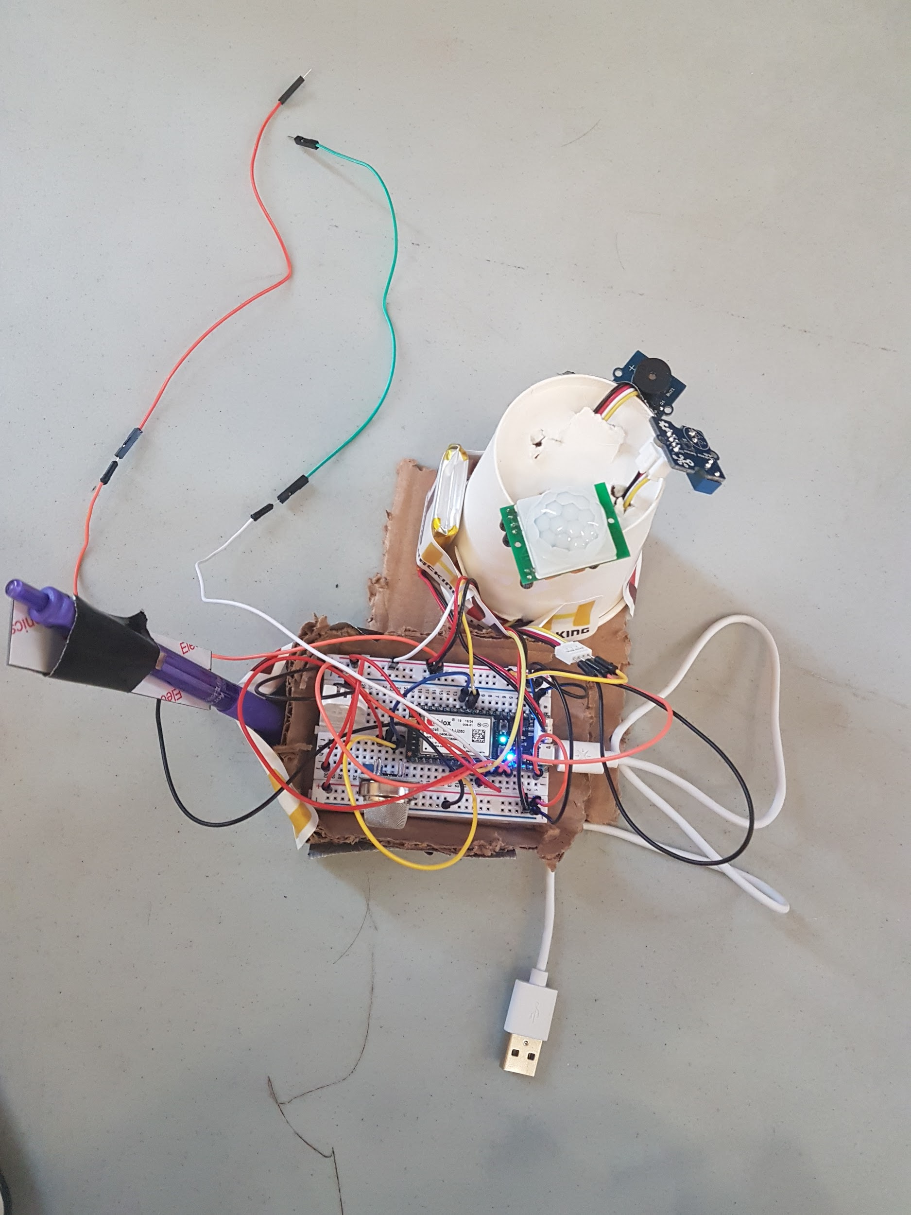
We - CU
The assurance you’ll love, wherever you are

Slide 2

Mission statement: Providing quality safety and comfort from afar

Slide 3



The Problem
Is your home really as safe as you think it is?
http://www.parachutecanada.org/injury-topics

Slide 4

The solution
All in One
Monitoring System

Slide 5
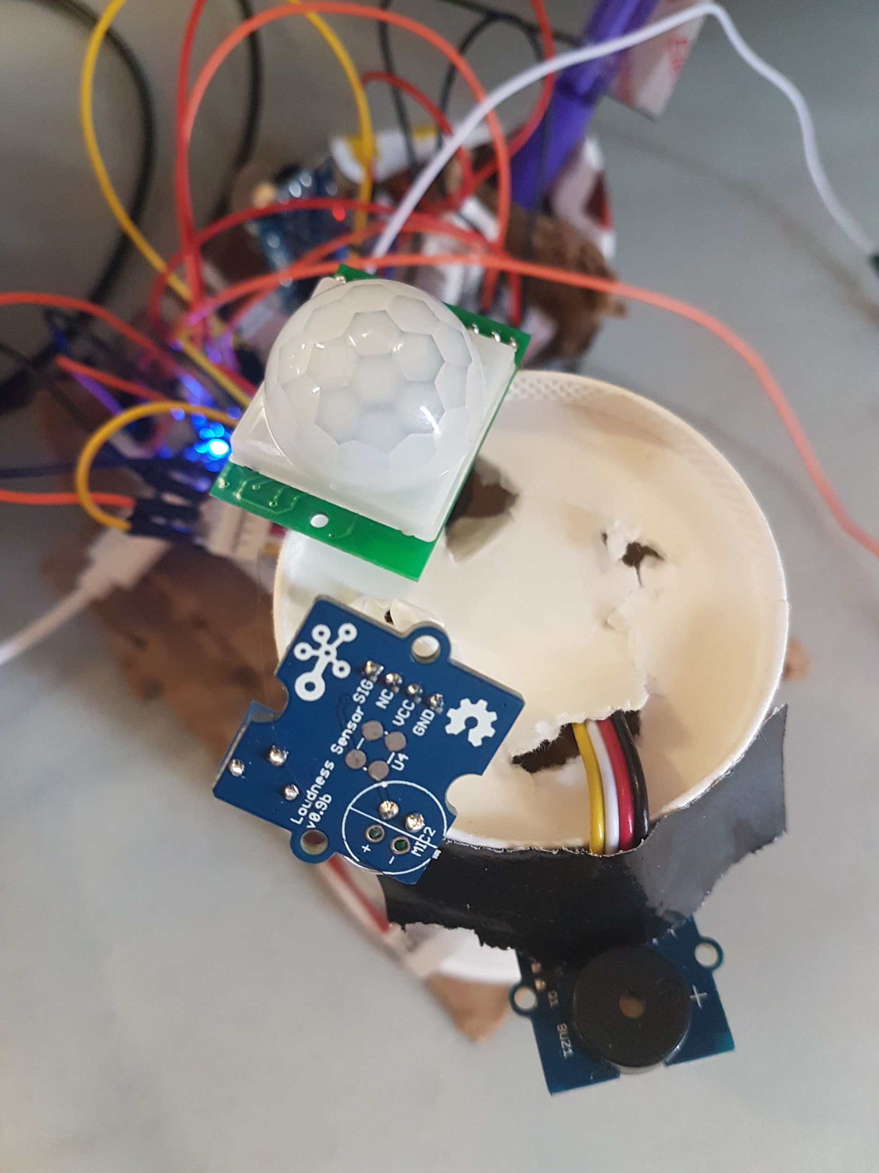
Features
Motion Sensor
Volume Sensor
Alarm

Slide 6
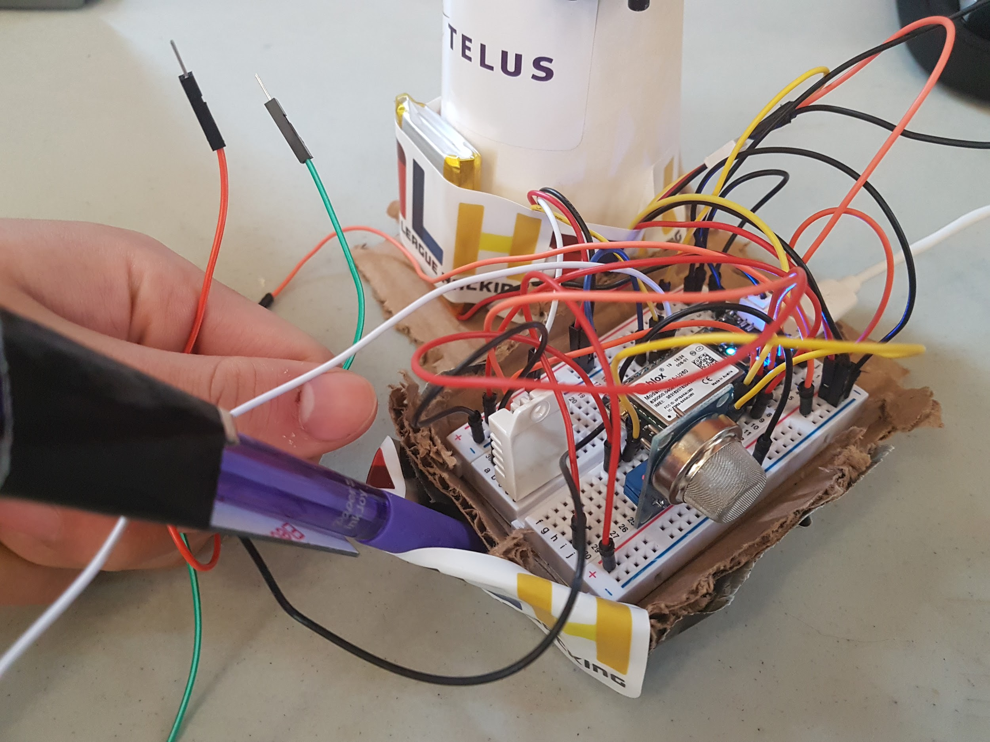
Features
Flood Detector
Gas Detector
Temperature & Humidity Sensor

Slide 7
Features
It works offline
Doesn’t require power to use
Very responsive
Sends warning messages
Customizable

Slide 8

Thank You!
Questions?

